Slide 1
Changes in lectures
22.04.2019 (No Lecture) -> Move to the next week
06.05.2019 (No lecture) -> Move to the next week

Slide 2
Mobile apps architectures

Slide 3
mobile app architecture
A way to structure project
A way to manage code readability & understability
A way to guarantee code modularity
A way to speedup and reduce costs for project maintenance (in a long run)

Slide 4
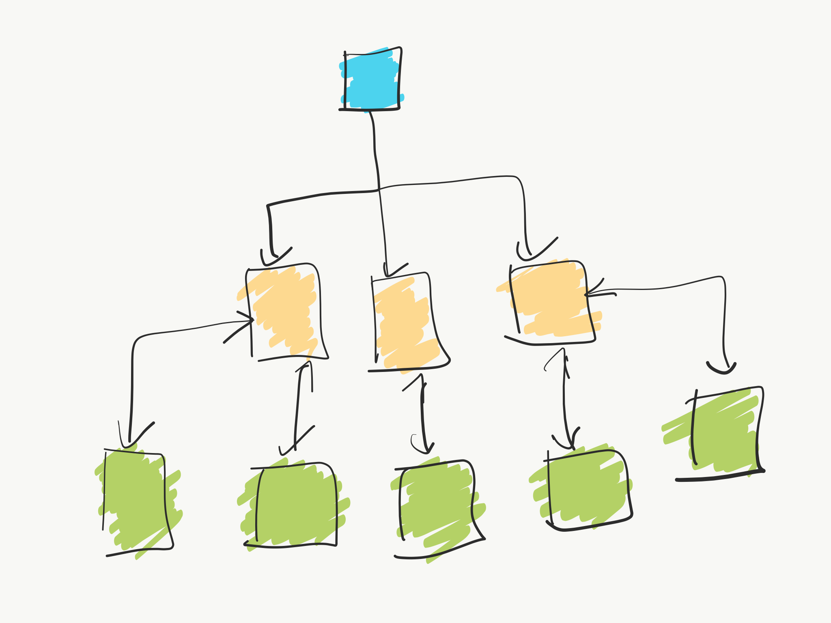
App Architecture

Slide 5
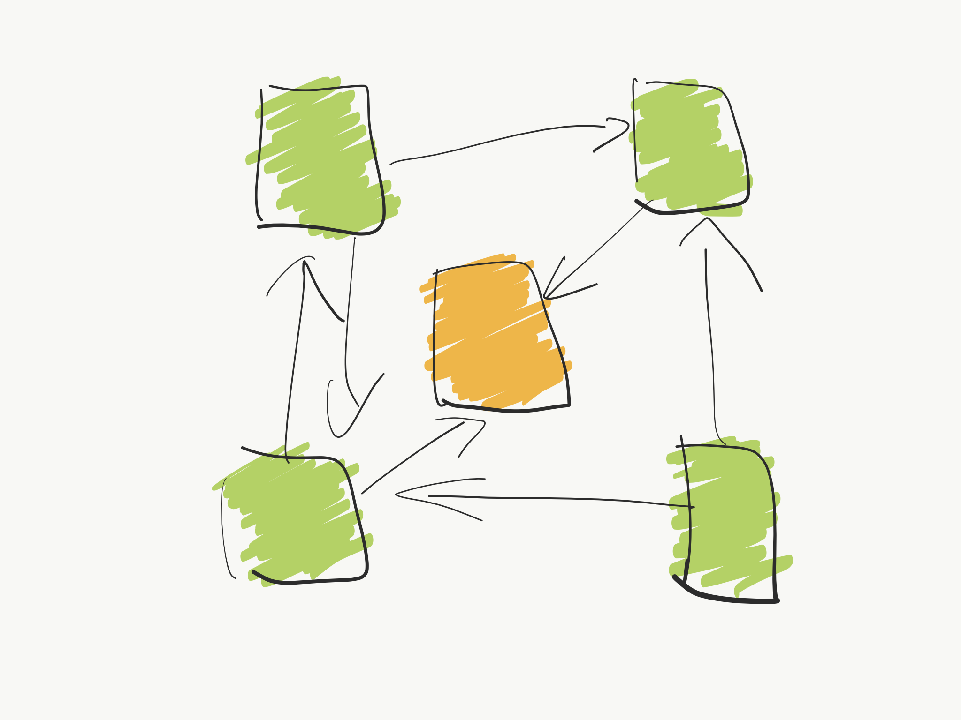
Design Patterns

Slide 6
Advantage of having a defined architecture
Your code is even more easily testable
Your code is further decoupled (the biggest advantage.)
The package structure is even easier to navigate.
The project is even easier to maintain.
Your team can add new features even more quickly.

Slide 7
Disadvantages of a Defined Architecture
That should be left blank ☺ But ok, there are some cons.
It has a slightly steep learning curve. How all the layers work together may take some time to understand, especially if you are coming from a project with no defined architecture at all.
It adds a lot of extra classes, so it’s not ideal for low-complexity projects.

Slide 8
There are no silver bullet
For each application type there are a different sets of architectures that would be in place for that type of apps.
For example architecture that is good for chat-like app probably wont be as good for a banking-like app.
The app could consists of a few different architectures, for example for a different types of tasks that app could perform.
Also architectures may be mutated in order to fit better with project needs.

Slide 9
Each architecture consists of:
Presentation Layer - contains UI components as well as the components processing them.
Business Layer - composed of workflows, business entities and components.
Data layer - comprises data utilities, data access components and service agents.

Slide 10
The typical architectures used for UI facing systems are:
MVC - Model View Controller
MVP - Model View Presenter
MVVM - Model View ViewModel
The community has largely moved away from the monolithic Model View Controller (MVC) pattern in favor of more modular, testable patterns.

Slide 11
MVC (Model-view-controller)

Slide 12
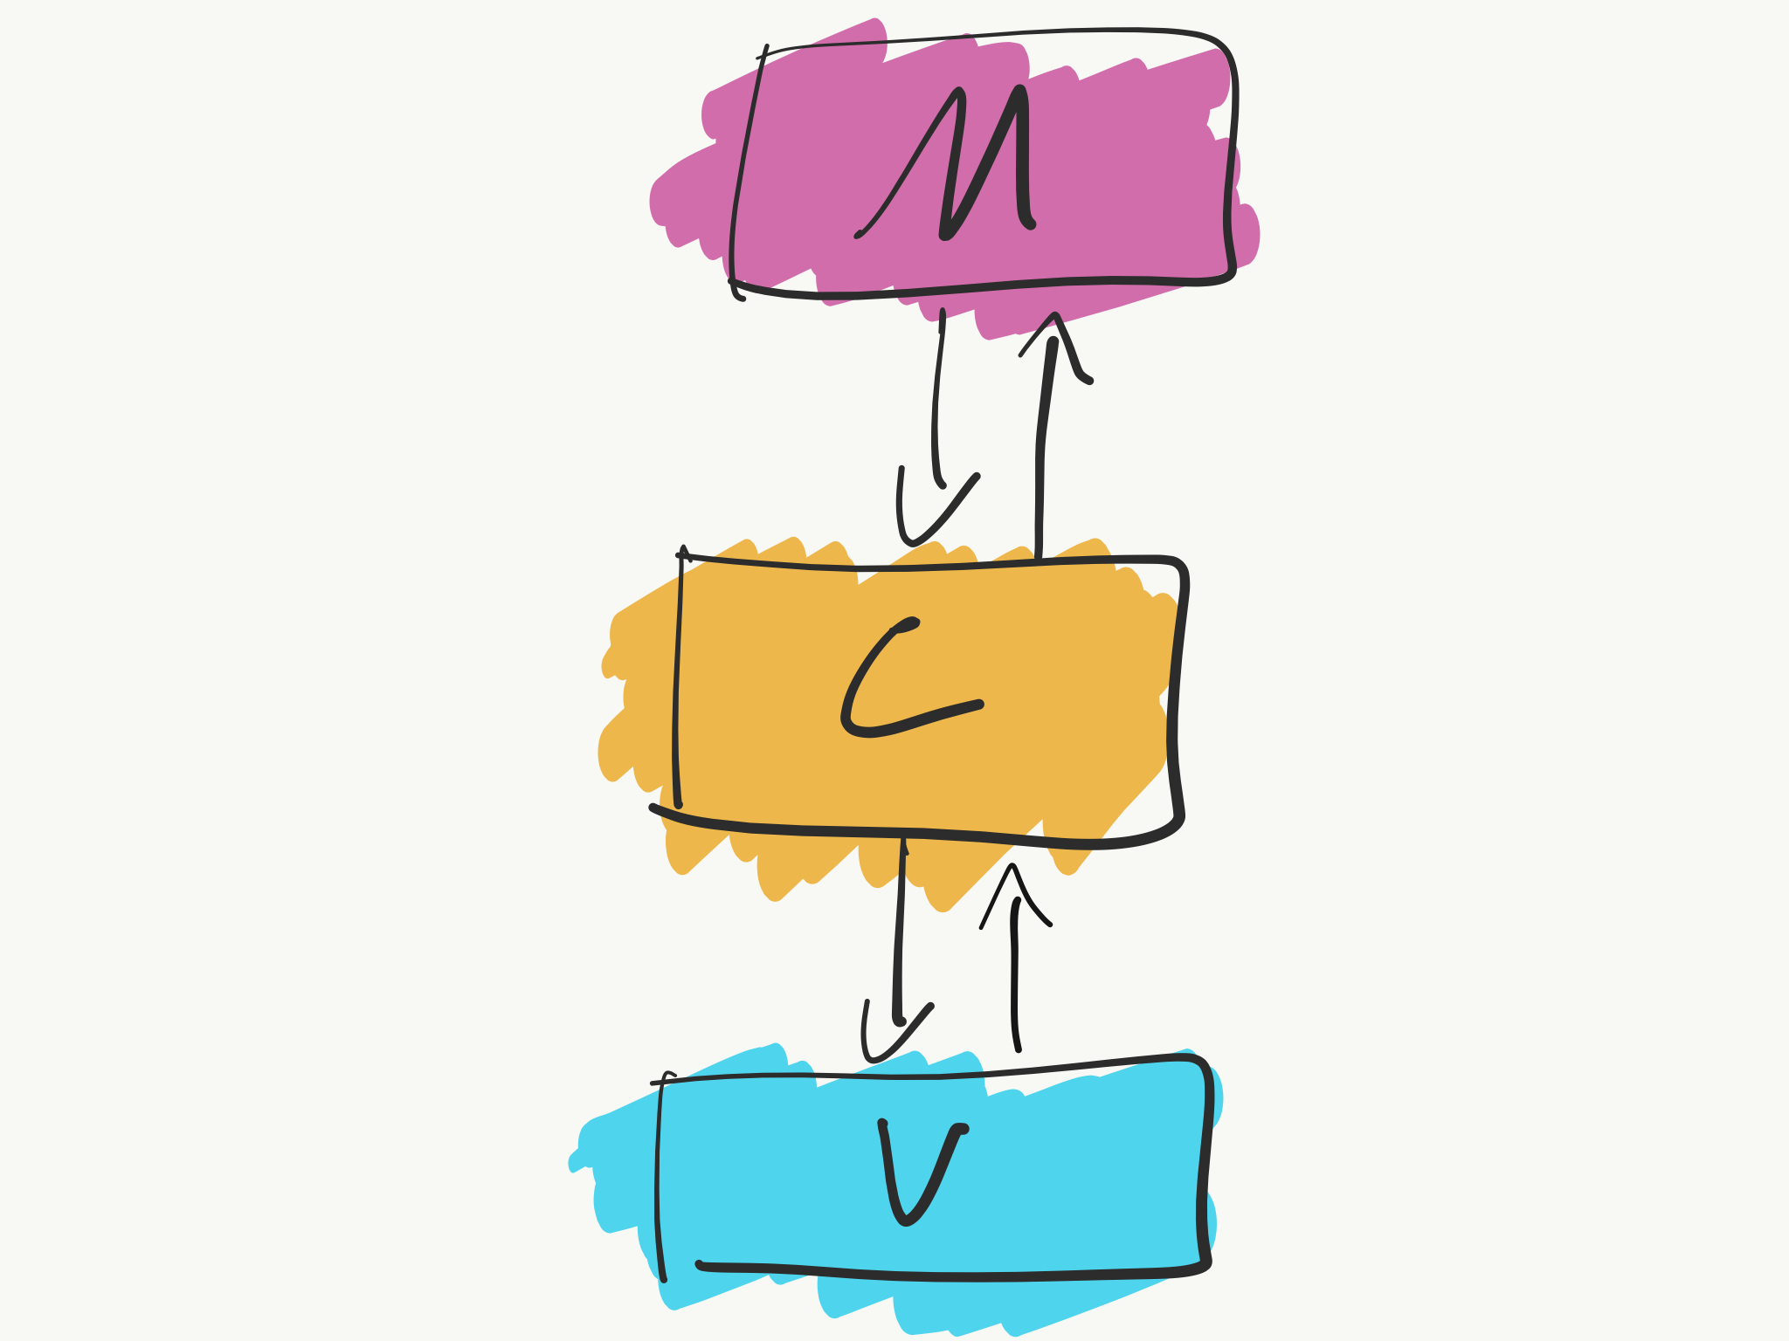
mvc

Slide 13
MVC
Model — the data layer, responsible for managing the business logic and handling network or database API.
View — the UI layer — a visualization of the data from the Model.
Controller — the logic layer, gets notified of the user’s behavior and updates the Model as needed.

Slide 14
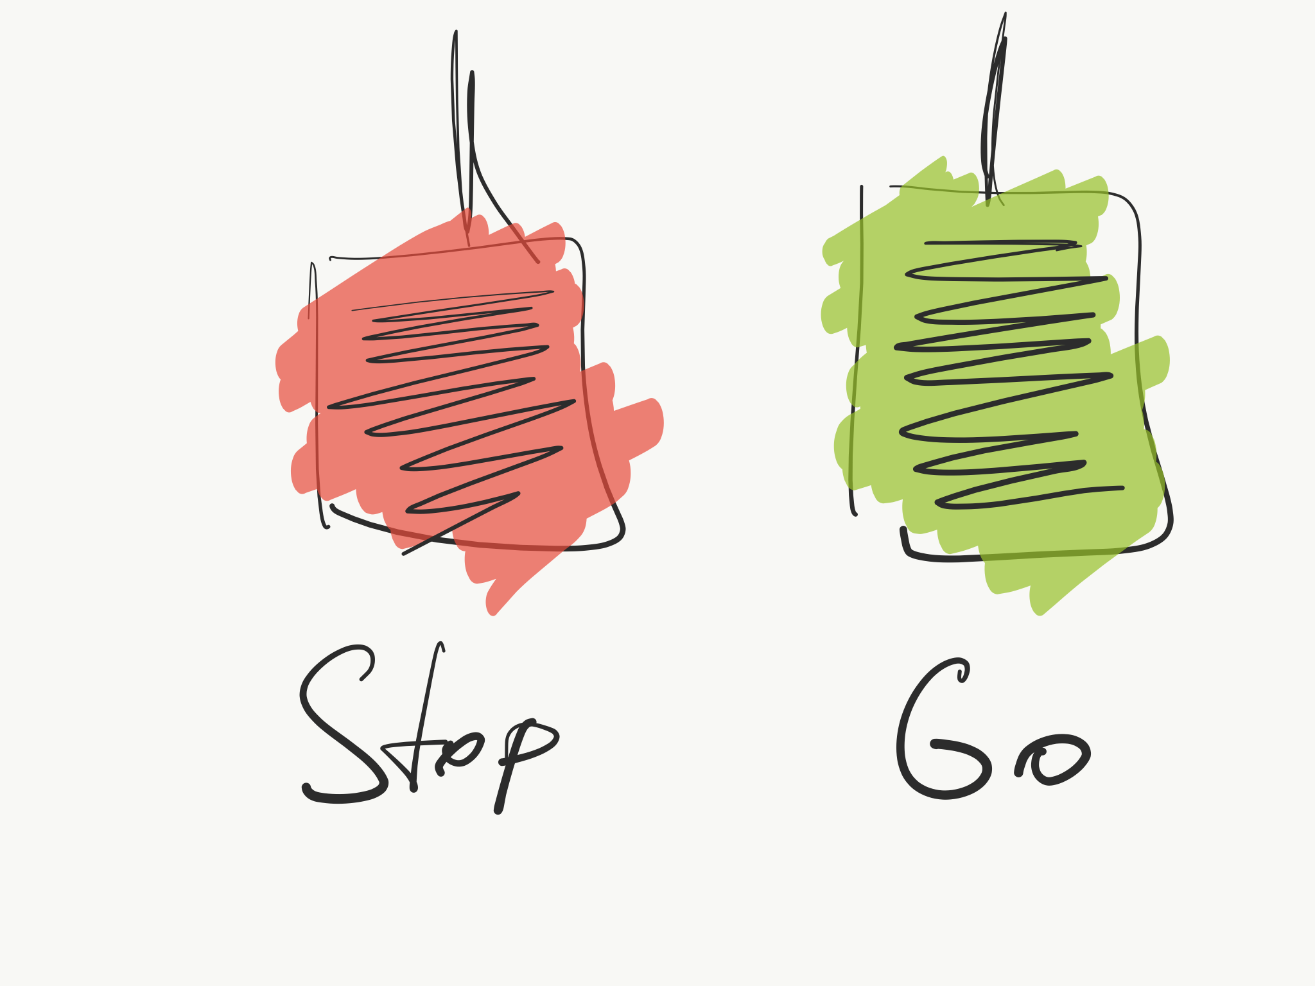

Slide 15
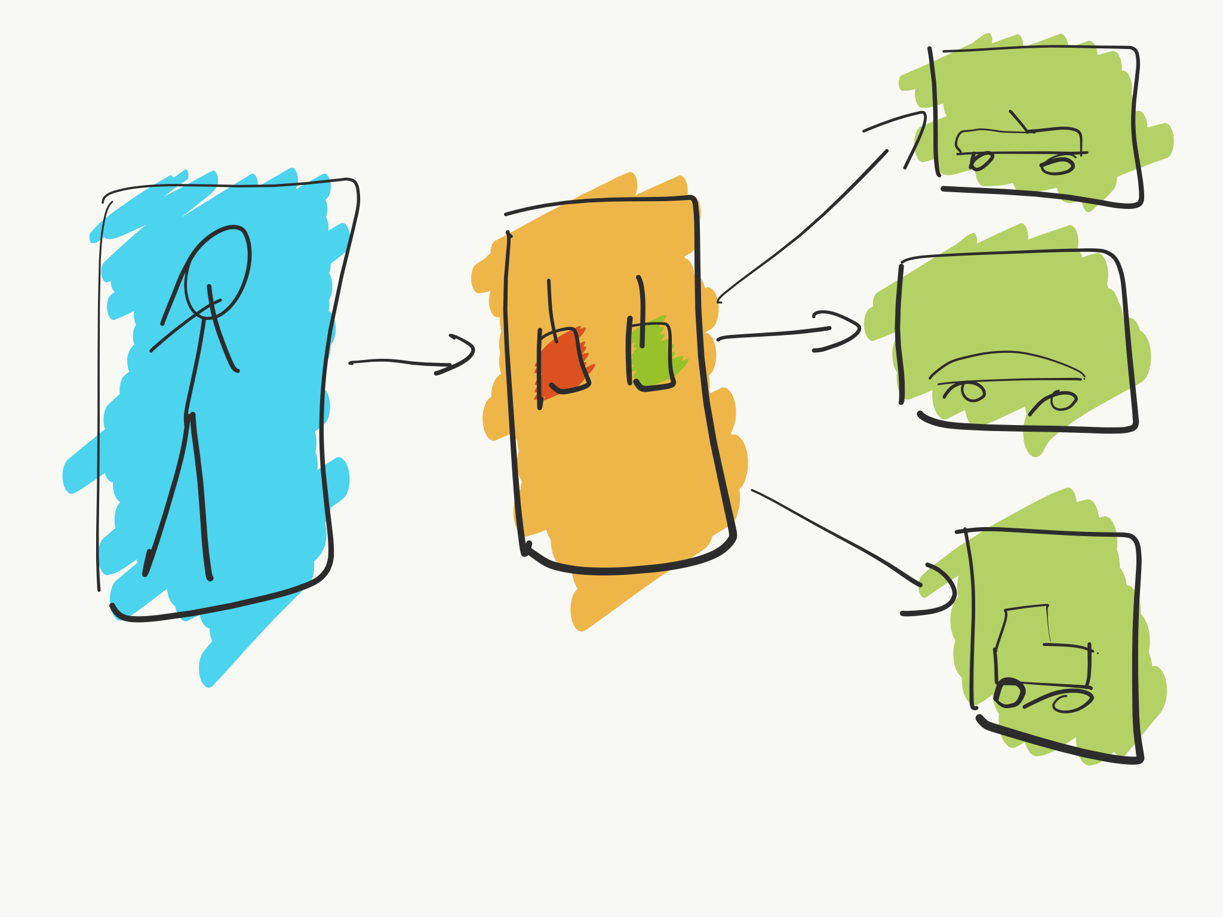

Slide 16
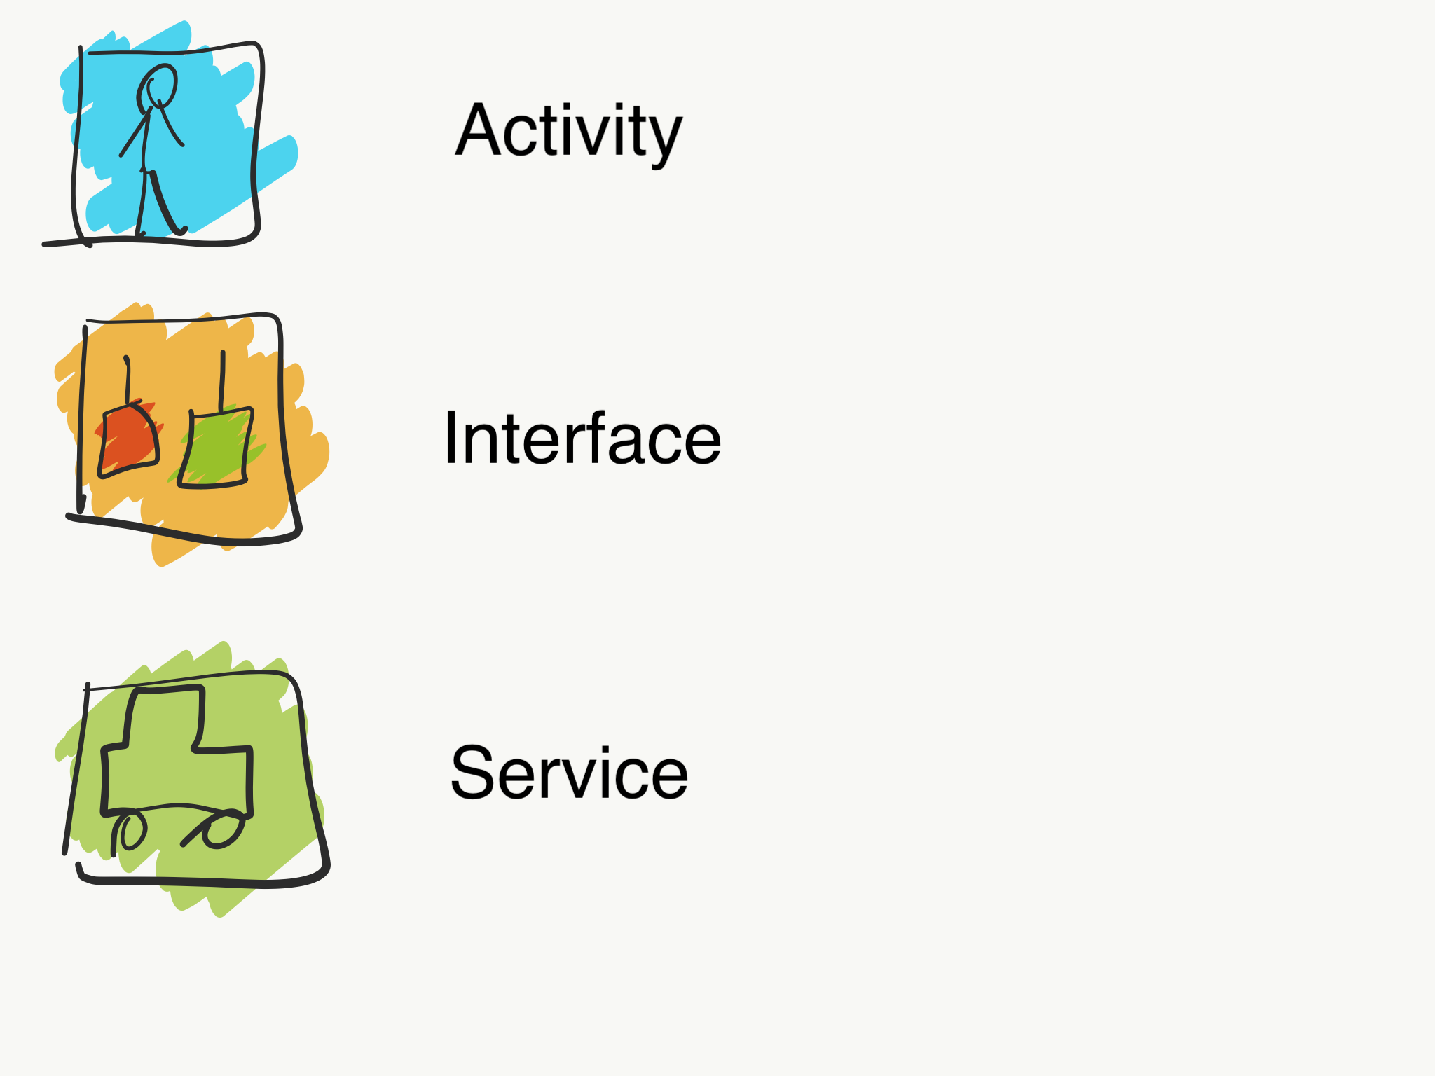

Slide 17
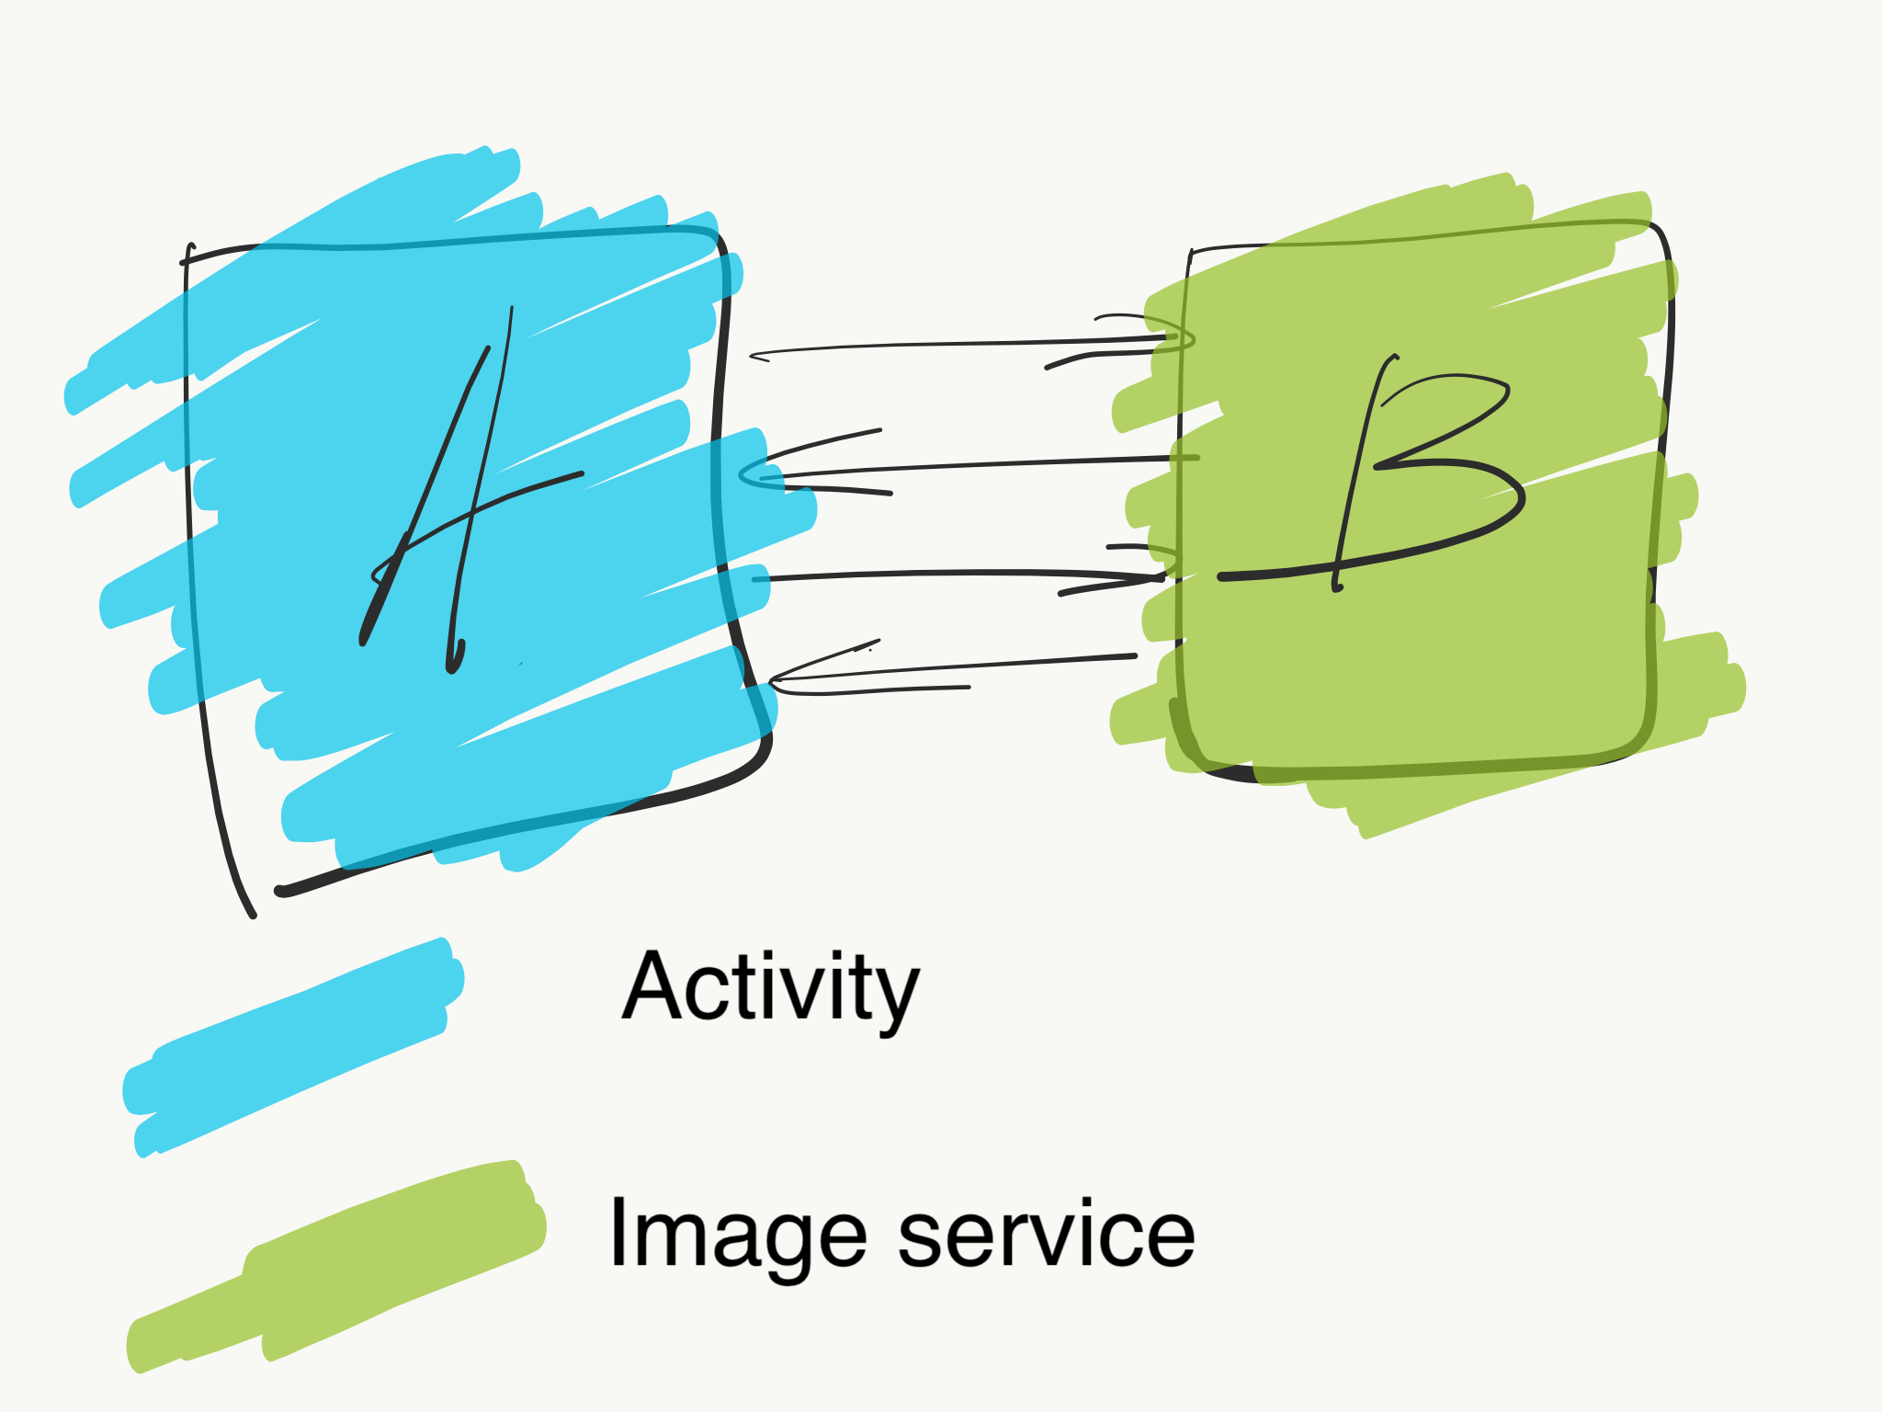

Slide 18
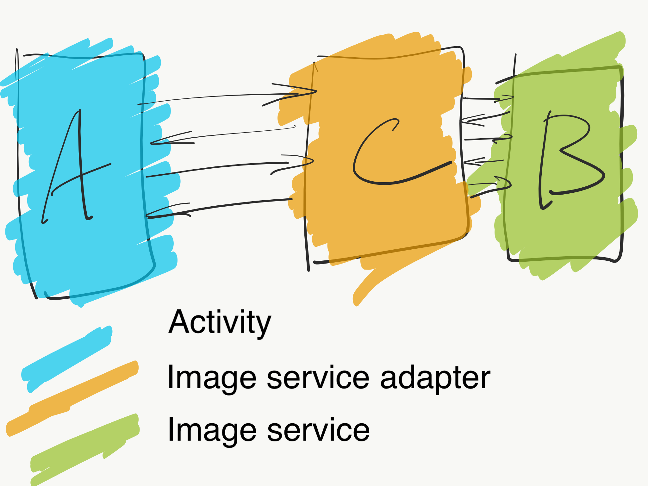

Slide 19
MVP (model-view-presenter)

Slide 20
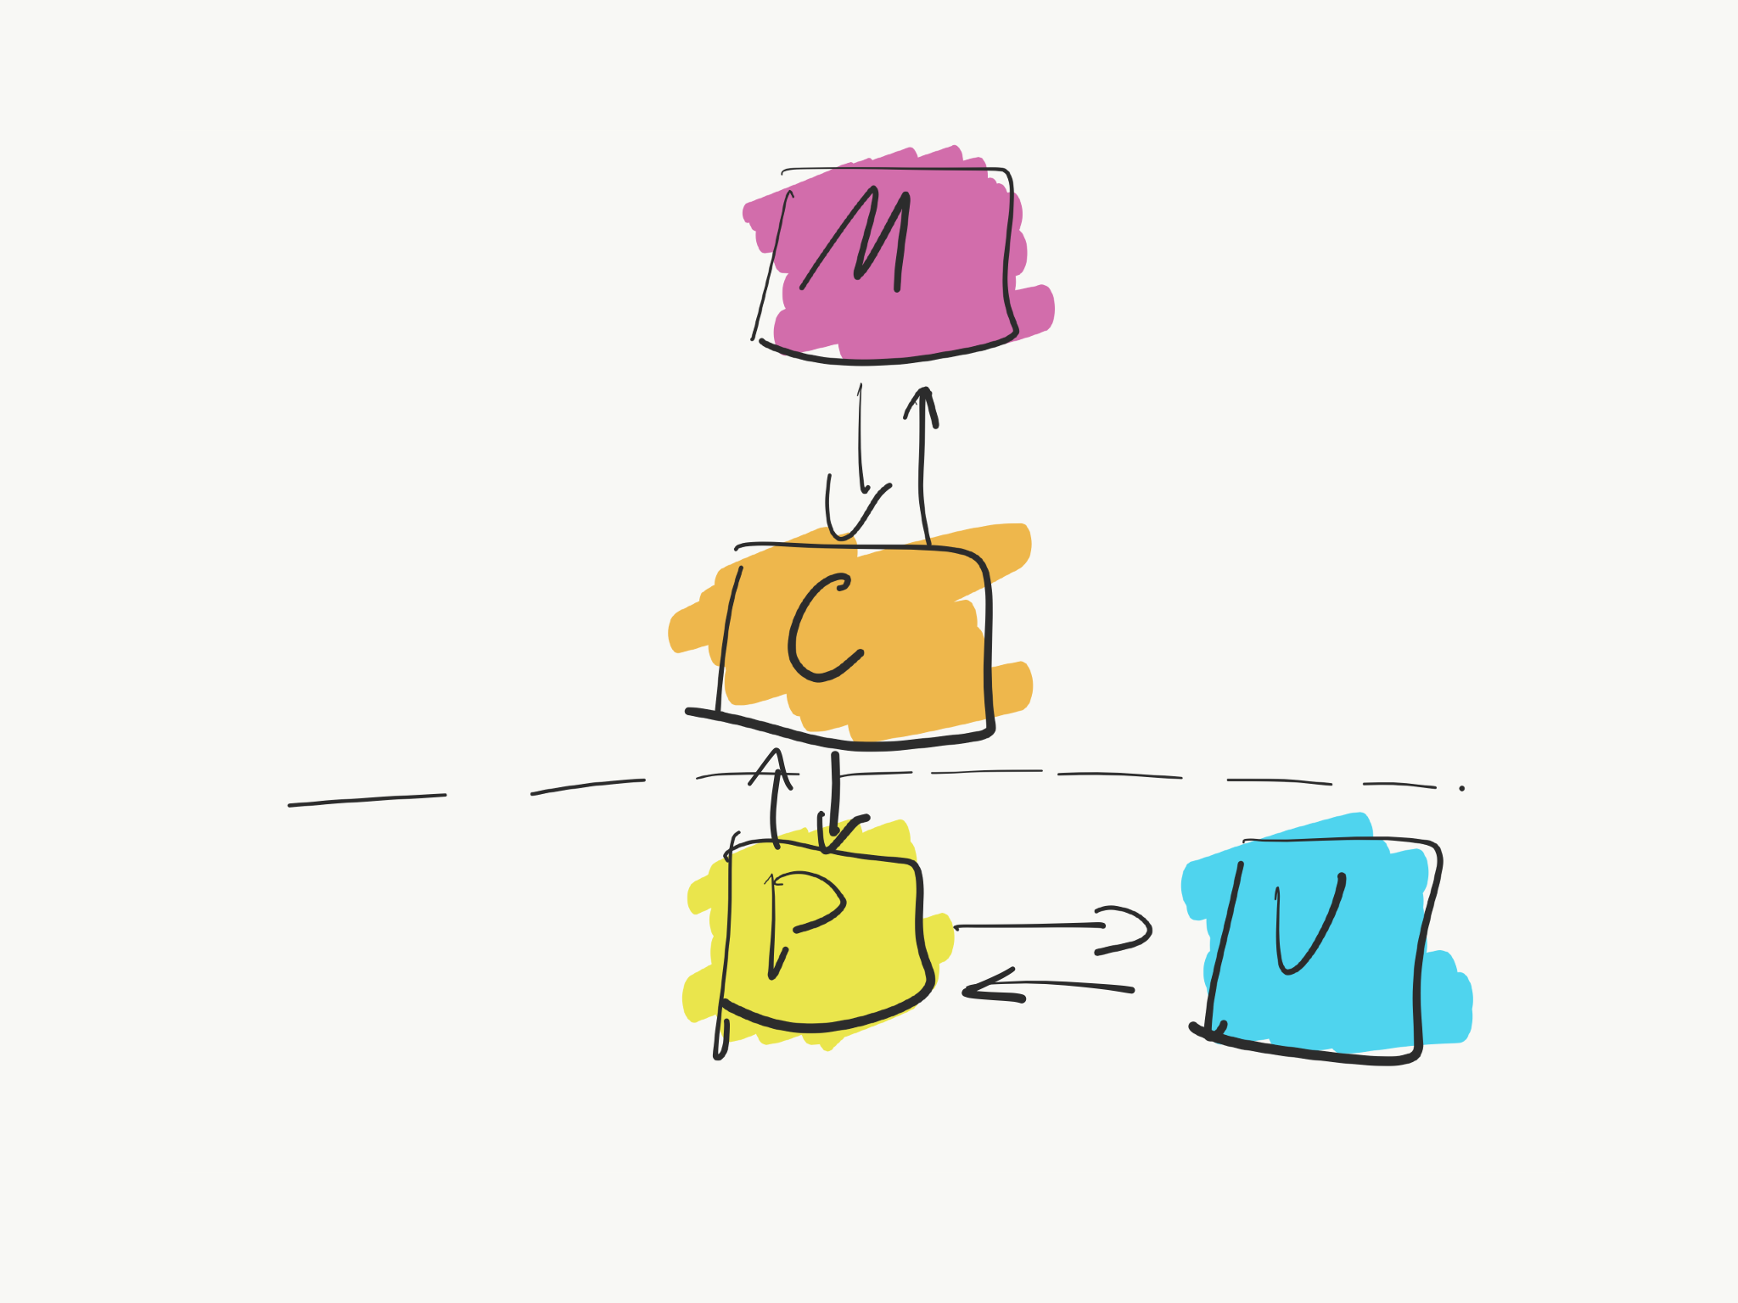
MVP

Slide 21
MVP
The MVP pattern allows separating the presentation layer from the logic so that everything about how the UI works is agnostic from how we represent it on screen. Ideally, the MVP pattern would achieve that the same logic might have completely different and interchangeable views.

Slide 22
MVVM (Model-view-viewModel)

Slide 23
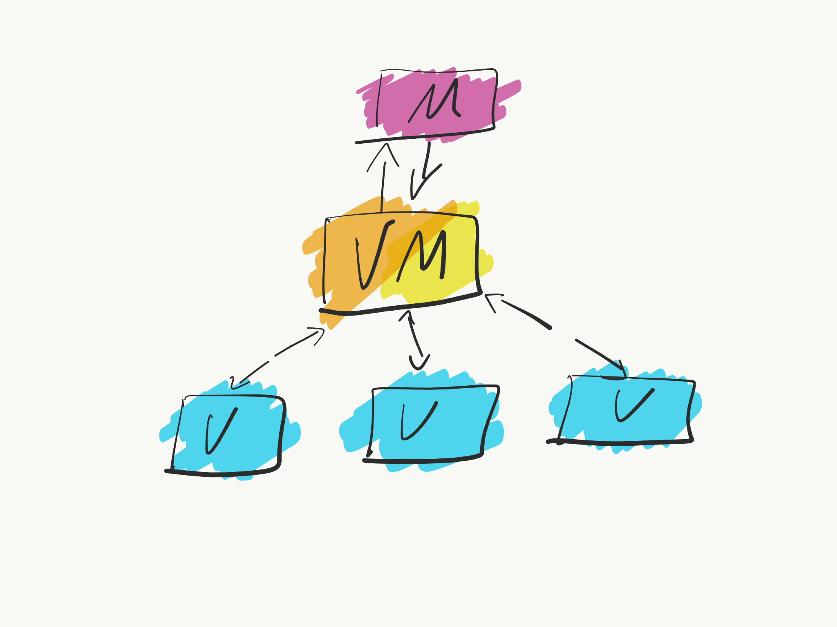
MVVM

Slide 24
MVVM
Works only if platform of implementation allows to bind views elements (onClickEvent, etc)
Differ from MVP in that ViewModels does not know about view (in MVP presenter knows about view). View is binded directly to ViewModel properties.
Is better than MVP since you don’t need to write a lot of similar code in order to connect view with presenter properties.

Slide 25
MVVM
Originally introduced by microsoft https://docs.microsoft.com/en-us/previous-versions/msp-n-p/hh848246(v=pandp.10)

Slide 26
Reactive Programming & RxAndroid

Slide 27
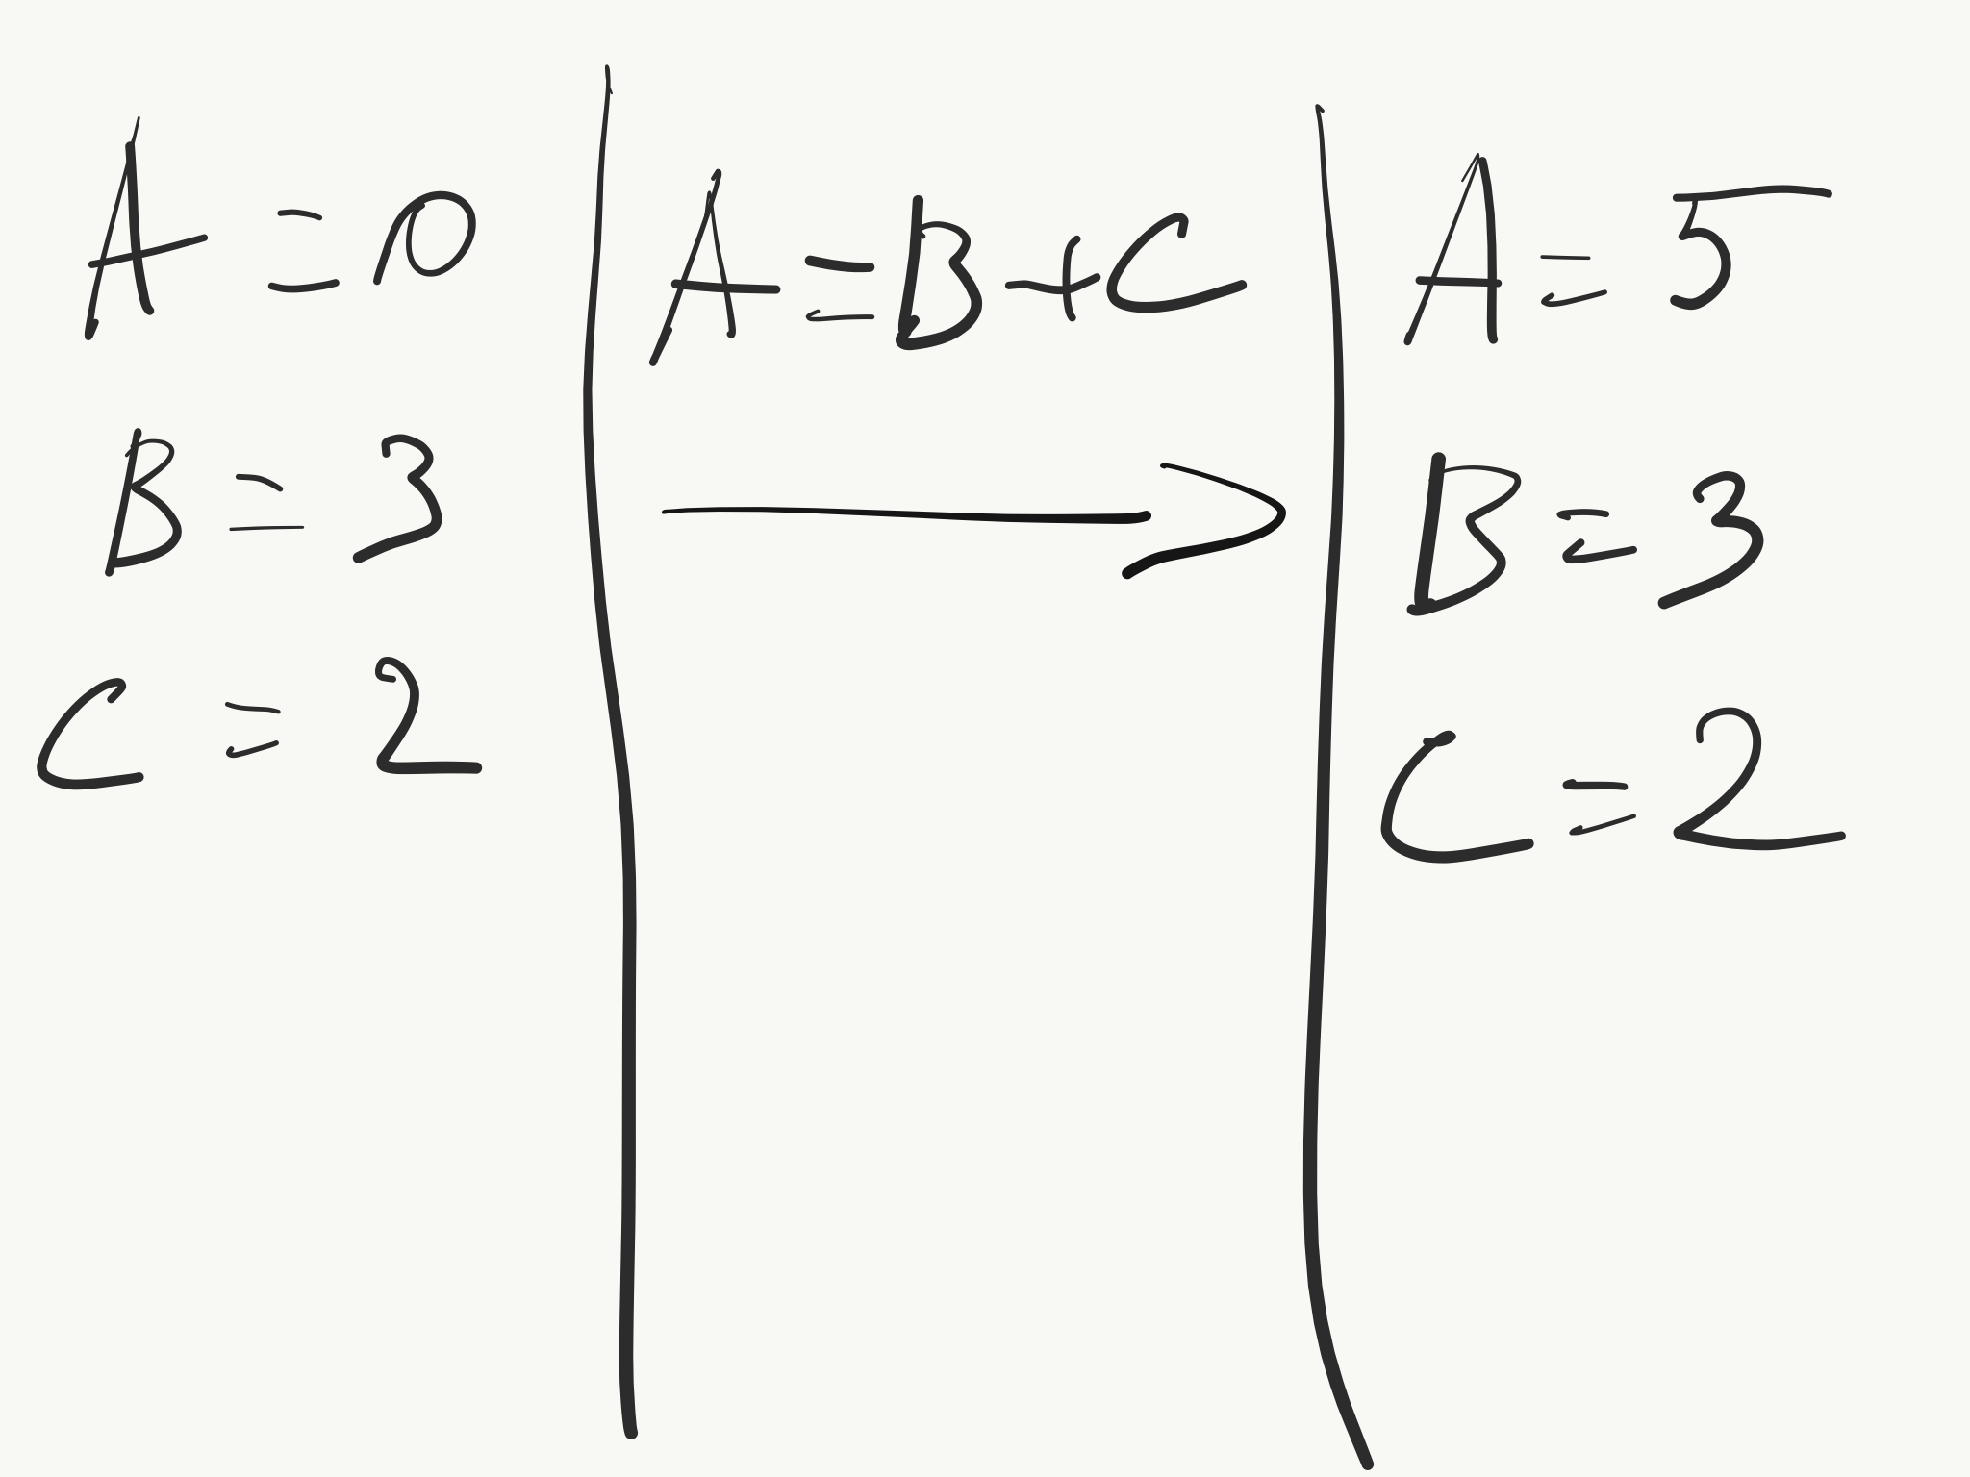

Slide 28
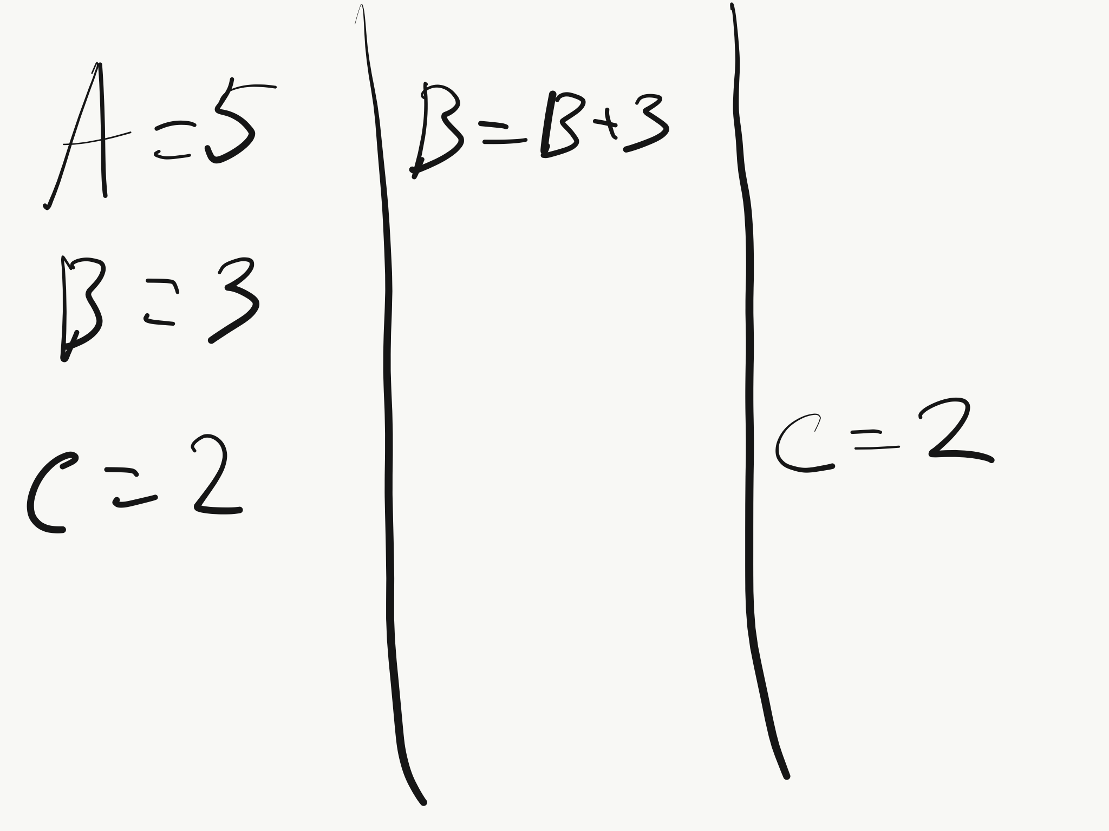

Slide 29
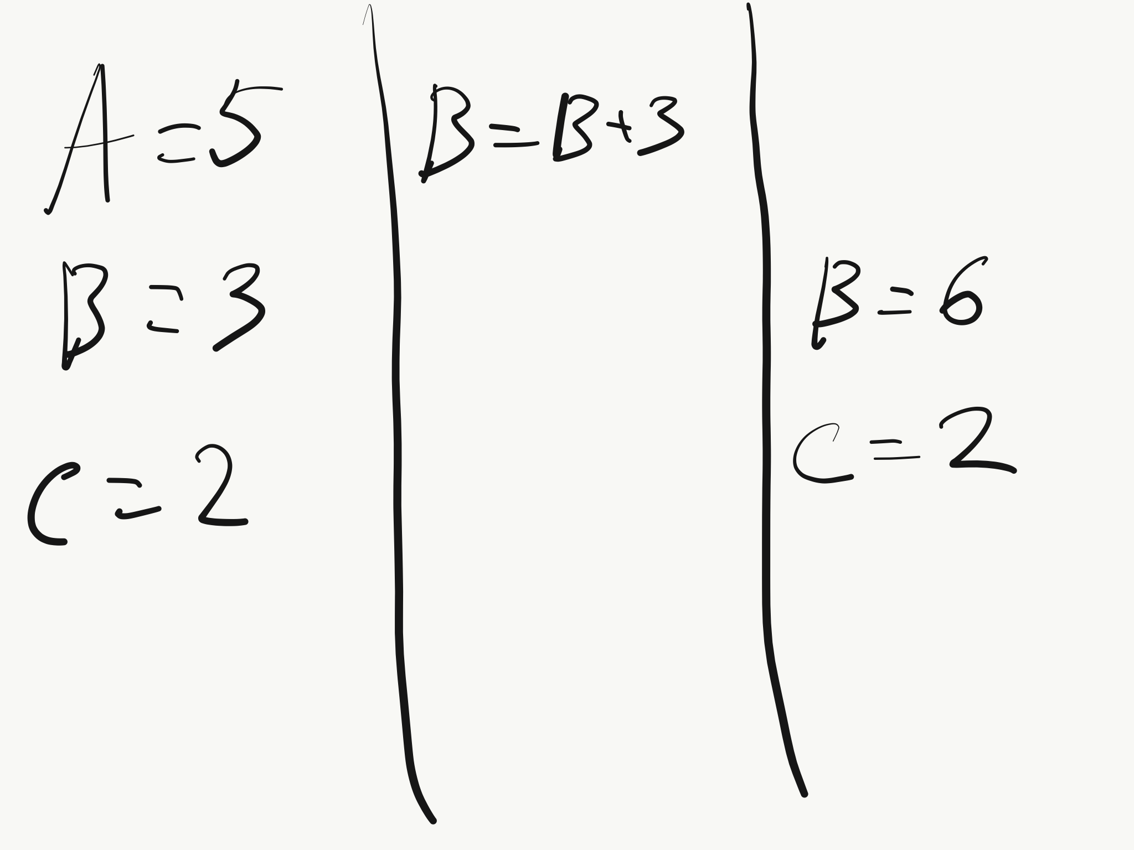

Slide 30
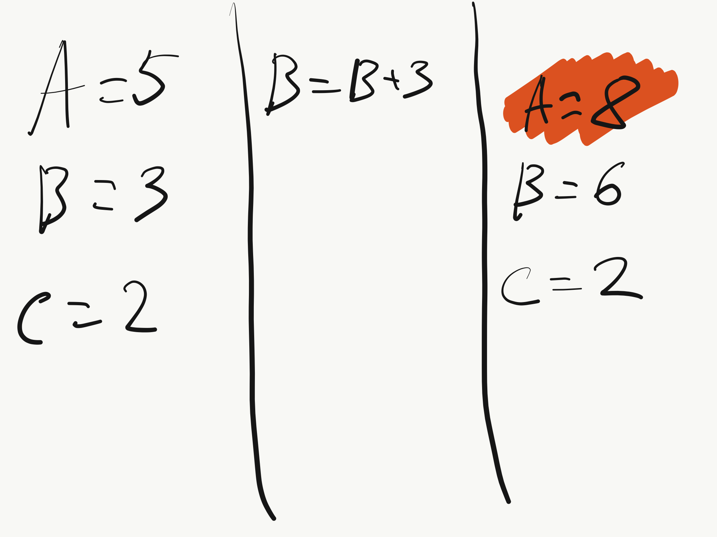

Slide 31
Reactive Programming
Non-reactive: A = B + C. After that changing B or C would not change the value of A.
Reactive : A = B + C. Change of B or C would change the value of A.
Reactive programming can facilitate changes in an underlying model that are reflected automatically in an associated view without touching the controller
Its an addition to a master architecture of app

Slide 32
RxAndroid
Library to easily use Reactive approach in development
https://github.com/ReactiveX/RxAndroid

Slide 33
Read more:
Clean Code http://blog.cleancoder.com/uncle-bob/2012/08/13/the-clean-architecture.html
Reactive Architecture https://android.jlelse.eu/reactive-architecture-7baa4ec651c4
MVC/MVP/MVVM - https://habr.com/post/215605/

Slide 34
Homework:
Open MainActivity of Lesson 5 and see :// TODOs ☺

Slide 35
Changes in lectures
22.04.2019 (No Lecture) -> Move to the next week
06.05.2019 (No lecture) -> Move to the next week

